Slide 1
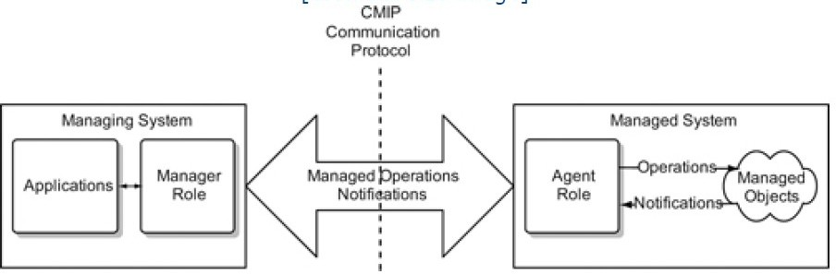
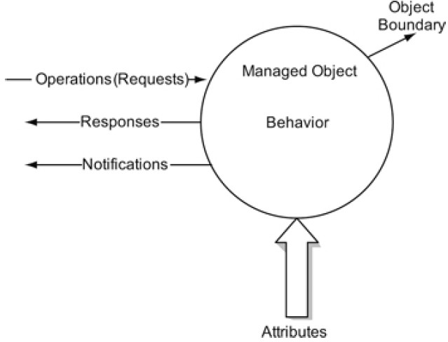
Telecomm Network Management
Module 2 contd.... OSI Management
System Overview
Figure 1 shows the OSI management model, defined in ISO 10040/X.701. The managing system consists of an entity playing the manager role and applications that perform the various functions. The managed system comprises the agent role function and managed objects. The managing system performs various operations, such as get and set. The role of agent is to perform the operations on managed objects and receive notifications from them. The communication protocol between the managing system and the managed system is the CMIP.
Figure 1 : OSI Management Model
In OSI the managed object is object oriented. A managed object representation in OSI is shown in Figure 2. As OSI is object oriented, the resources are represented as managed object classes. The internal charateristics of a managed object are hidden from the external view, and are specified as attributes at the object boundary. The inner behaviour of the managed object caused by external operations is reflected as changes in attributes and is sent out as notifications. The operations sent out by the management system as requests requiring responses are part of operations and generates responses by the managed system.
Figure 2 : OSI Managed Object

Slide 2
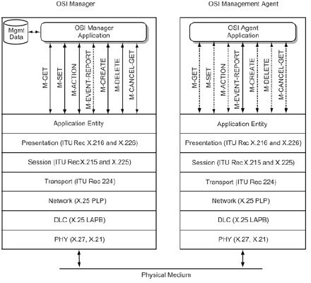
Telecomm Network Management
The OSI management system architecture is shown in Figure 3. It consists of seven messages representing seven services, called Common Management Information Service Elements (CMISEs). The communication protocol used by CMISE is the Common Management Information protocol (CMIP)
Figure 3 : OSI Management System Architecture
All but one, M-EVENT-REPORT , are generated by the manager and are represented as solid lines in the OSI manager application layer. They are shown as dashed lines in the OSI agent application layer.
The M-EVENT-REPORT is shown as a solid line in the agent layer and as a dashed line in the manager layer. All messages are represented by double arrows in both the manager and the agent layers because messages may elicit or require either response(s) or confirmation.
Messages are generated by application processes and are transferred to the presentation layer via an application entity sublayer in the application layer. The other upper layers of the OSI Reference Model consists of presentation and session layers as described in ITU Recommendations X.216 and
X.226 for the former and X.215 and X.225 for the later.

Slide 3
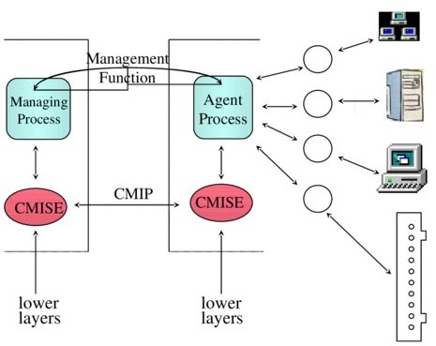
Telecomm Network Management
The lower layers of the model may be either connection oriented or connectionless. Numerous choices in the set of lower layer protocols are available.
M-GET
This service comprises request and response messages. The M-GET requires confirmation from the agent.
M-SET
This service enables setting up attribute values in the managed object and may or may not require confirmation.
M-ACTION
This service is used to perform operations in the managed object, and confirmation is optional.
M-CREATE & M-DELETE
These services are used to create and delete object classes, for which there is no equivalent in SNMP. Both these OSI messages require confirmation from the agent.
M-CANCEL-GET
An M-GET request message may be canceled by using the M-CANCEL-GET message, which requires confirmation from the agent.
M-EVENT-REPORT
This service is akin to the trap message in SNMP, but it has a much broader effect than the few generic alarms in SNMP
Figure 4 : OSI system Architecture CMIS/CMIP

Slide 4
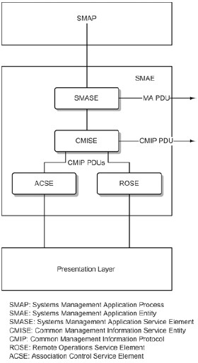
Telecomm Network Management
Communication Model
The manager and agent application processes uses seven messages to communicate with each other. The application process interfaces with the application entity sublayer that is above the presentation layer. The communication protocol used for intersystem communication is the Common Management Information Protocol (CMIP). The communciation model deals with the application entity layer and the intersystem message protocol.
System Management Application Entity
A management application, the System Management Application Process (SMAP) communicates with another mangement application by invoking System Management Application Entity (SMAE), as shown in Figure 5. The SMAE comprises several service entity modules. The System Management Application Service Entity module (SMASE) services the five management applications : configuration, fault, performance, security and accounting.
Figure 5 : OSI Network Communcation Model

Slide 5
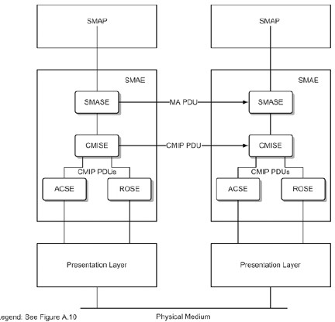
Telecomm Network Management
The CMISE handles the communications functions for SMASE, using the CMIP. The Association Control Service Element (ACSE) sets up and coordinates the activities of setting up and releasing an association with the application. Once the association has been set up, the data move from the CMISE to the remote system via the Remote Operation Service Element (ROSE). ROSE issues requests to a remote system and receives responses in an asynchronous mode. In other words, a request may be isssued and followed by other request and the responses correlated with the corresponding requests.
Figure 6 shows the interoperability of two appliocations in two remote systems for the OSI network communication model as shown in Figure 1. Communication between SMASE entities exchange management application protocol data units (MA PDU). CMIP PDUs are exchanged between CMISE entities.
Figure 6: OSI Interoperability Communication Model

Slide 6
Telecomm Network Management
Common Management Information Service Elements
The CMISE offers services or message . The seven messages representing the seven services, called Common management Information Service Elements (CMISEs). The communication protocol used by CMISE is the Common management Information Protocol (CMIP)
M-GET | M-SET | M-ACTION | M-EVENT-REPORT
M-CREATE | M-DELETE | M-CANCEL-GET
The CMISE model consistes of two submodels. In the first, the manager sends a command to an agent and may expect one or more responses from the agent, which is called operations. The second submodel is concerned with an unsolicited message from an agent, which may expect confirmation from the manager, and is called notification. The commands M-GET, M-SET, M-ACTION, M- CREATE,M-DELETE and M-CANCEL-GET are operations. The event M-EVENT-REPORT belongs to notifications.
The M in all the operation and notification command names stands for management. The get, create, delete, and cancel-get operations expect confirmations or responses, called confirmed services. A response may be multiple. For example, the GET command associated with a multiple management object class (called scope) could invoke multiple responses.
The operation set and action, as well as the notifications event-report, may or may not require responses or acknowlegdements. They can be either confirmed or unconfirmed services. The requirement for confirmation depends on the type of operations or notification, and the data format should specify it. The CMISE services and CMIP operation values are listed in the table, along with a brief description of each service.
SERVICE | OPERATION VALUE CONFIRMED/ UNCONFIRMED | DESCRIPTION
M-EVENT- REPORT | 0/1 | Send notification to another open system
Multiple responses | 2 | Not a CMISE service, but used with scope
M-GET | 3 | Retrieve attributes managed objects | and values | from
M-SET | 4/5 | Set or modify attributes
M-ACTION | 6/7 | Initiate action in a manged object
M-CREATE | 8 | Request an open managed objects | system to | create
M-DELETE | 9 | Request an open managed objects | system to | delete
M-CANCEL-GET | 10 | Commands to cancel a previously sent M- GET service

Slide 7

Telecomm Network Management
Common Management Information Protocol
The CMIP is the communication interface with the CMISE. It generates a PDU for a message. The PDU format generated by CMIP is a modification of the generic ROSE PDU format as shown in Figure 7. The invoke ID field is the PDU identifier and is used in correlating the response. The operation value is determined by the appropriate operation/ notification as in Table. For example , the get operation will have an operation value of 3. the next two fiels in the CMIP PDU are the managed object class and the managed object instance. The term base object is used in connection with retrieval using the get commands by specifying a base object. The information field is a group of fields describing operation-specific data.
Figure 7 : CMIP PDU
APPLICATION FUNCTIONS MANAGEMENT
OSI management had paid specific attention to the development of management applications (functional model), which motivated development of the rest of the OSI management model. Application functions management can be compartmentalized as shown in Figure 8, as management application functional areas, system management functions (SMFs) and CMIDEs. Management application functions invoke SMFs, which in turn utilizes the common managemnt information services to execute applications.
The five system application functional areas are configuration, fault, performance, security and accounting. They are represented as clouds in Figure 8 because the functional areas overlap. For example, packet loss in a network could be classified under both fault and performance management. They may even use common management functions. Hence OSI specifications for SMFs are for primitive service functions.
The SMFs are abstract specifications, more like requirements of the functions needed to implement the applications. They are shown under SMFs in Figure 8. The purpose of most of the functions can be inferred from the title. The object management function, state management functions and attributes for representing relationships are concerned with the configuration of managed objects. The management knowledge function exchanges information between systems.
The event report management function, log control function, alarm reporting function, test management function, and confidence and diagnostic test categories are oriented towards fault adminstration and notifications. The summarization function could be used for fault management, as in trouble ticket adminstration, or for performance management , as with statistics. The function preprocesses and compresses the data prior to transmission.
The SMFs related to security management applications are the security alarm reporting functions, security audit trial function, and object and attributes for access control. The account metering function are workload monitoring function are oriented towards accounting management. The scheduling function is a general SMF used to schedule operations.

Slide 8
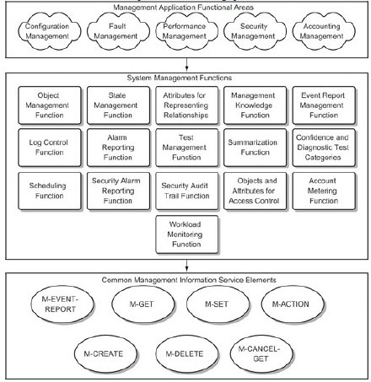
Telecomm Network Management
Figure 8: Functions of Management Model
The third compartment in Figure 8 identifies the common management service elements invoked by the SMFs to perform the tasks. They are the seven CMISE services: M-EVENT-REPORT, M-GET, M-SET, M-ACTION, M-CREATE, M-DELETE, and M-CANCEL-GET.

Slide 9
